Slide 1
MS4 Permit/JRMP/WQIP
March 7, 2018

Slide 2
San Diego Region Municipal Stormwater Permit Overview of Order R9-2013-0001 as amended by order nos. R9-2015-0001 and R9-2015-0100
Issued by: California Regional Water Quality Control Board, San Diego Region
NPDES No. CAS 0109266
Presented by Stephanie Gaines and Reed Thornberry
County of San Diego / City of San Marcos
Watershed Protection Program / Stormwater Management Program
Notes:
10 Watersheds – San Diego County, South Orange County, and South Riverside County

Slide 3
Terminology
NPDES – National Pollutant Discharge Elimination System
MS4 – Municipal Separate Storm & Sewer System
WQIP – Water Quality Improvement Plan
JRMP – Jurisdictional Runoff Management Program / Plan
BMP – Best Management Practice(s)
TMDL – Total Maximum Daily Load

Slide 4
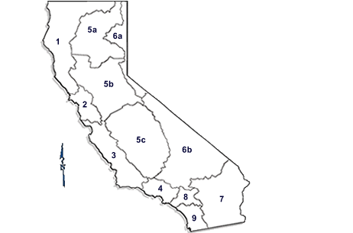
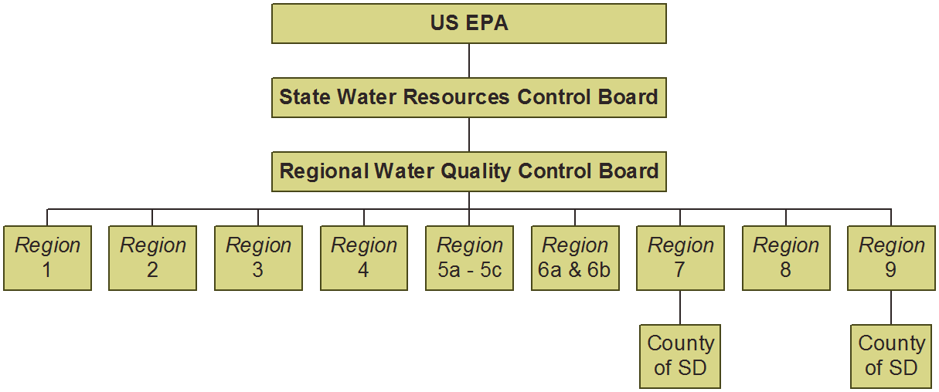
Regulatory Framework
Clean Water Act
Porter-Cologne Act
NPDES Permit
Notes:
Federal – Clean Water Act
Requires Municipalities Obtain NPDES Permit
Renew Every 5 Years
State – Porter Cologne Water Quality Control Act
SWRCB – Water Rights and Water Quality Policy
Local – Implement NPDES Permit
Copermittees – local municipalities / agencies named in the permit

Slide 5
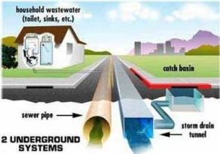
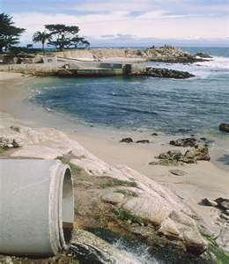
Municipal Storm Drains
Protecting Surface Water Quality from Polluted Discharges
Notes:
MS4 – owners / operators
What permit seeks to do
SDs not connected (very few exceptions)
Storm drains / conveyance systems can be closed or open systems – natural / concrete
Surface water impediments – goal: protect surface waters
Other types of Permits:
Tribal lands,
federal lands, state parks,
lands regulated by Phase II MS4 Permit
Conditional Waivers (Ag, other)
General Construction
Industrial

Slide 6
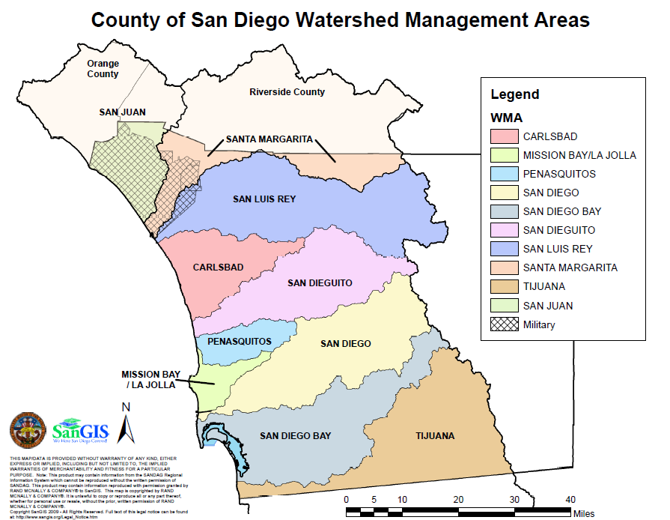
MS4 Permit Structure
1 Regional Permit
10 WMA Leads

Slide 7
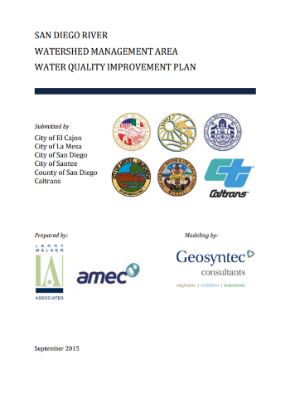
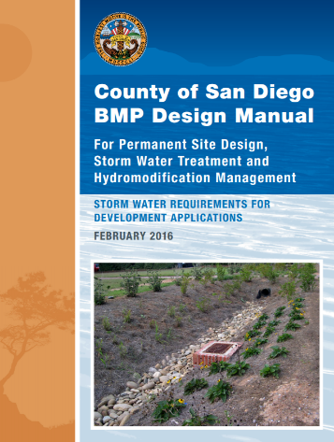
County of San Diego Plans, Regulations and Guidelines
WQIPs – Goals, Strategies, Schedules, Adaptive Management
Ordinances – Implements the Permit, Enforcement
BMP Design Manual – sets requirements and guidance for development projects
Standard Urban Stormwater Mitigation Plan (SUSMP)
Notes:
Some vehicles used by local Copermittees to implement the Permit…
County regs, codes, ordinances, guidelines include
WPO
WELDM
SUSMP (w/be BMP Des Manual)
RPO
BMO

Slide 8
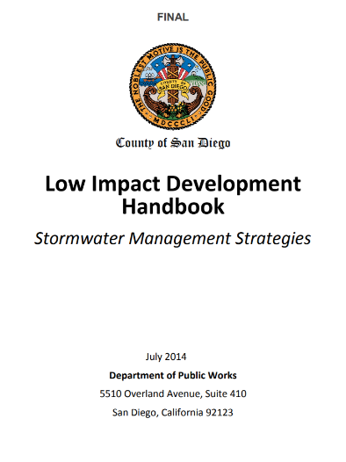
County of San Diego Plans, Regulations and Guidelines Cont.
Low Impact Development (LID) Handbook & Fact Sheets
Landscape Ordinance & Water Efficient Landscape Design Manual (WELDM)
Other jurisdictions use similar Ordinances, Programs, Handbooks, and Fact sheets
Notes:
Some vehicles used by local Copermittees to implement the Permit…
County regs, codes, ordinances, guidelines include
WPO
WELDM
SUSMP (w/be BMP Des Manual)
RPO
BMO

Slide 9
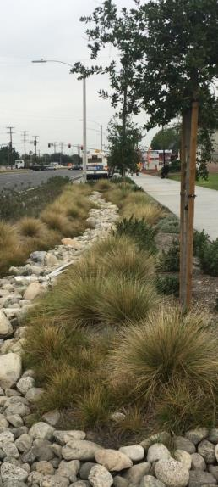
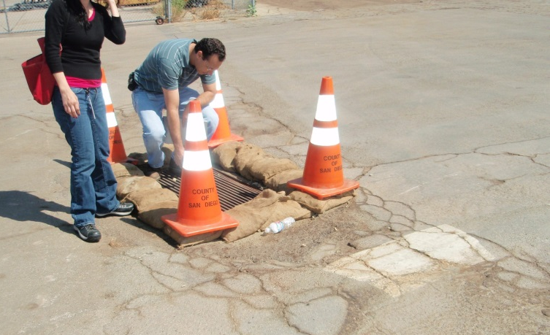
Jurisdictional Runoff Management Program (JRMP)
BMP Implementation / Maintenance
Site Inventory / Tracking
Inspections
Illicit Discharge Detection Elimination (IDDE)
Education and outreach
Training for Employees
Retrofit of Existing Development
Required Escalating Enforcement
Notes:
BMP implementation maintenance – com/industrial min set of BMPs for existing development
Escalating Enforcement
Backbone for our core programs
Provides mechanism to implement strategies
Illicit Discharge Detection Elimination (IDDE) program
Education and outreach
Inspections
Site Inventory / Tracking – Copermittees must maintain an inventory of com/ind sites, and if pos drainages

Slide 10
Our Goal
Our goal:
Comply with MS4 Permit
Ensure the public, facility operators, business owners are in compliance with stormwater regulations
Assist the public, facility operators, business owners , as feasible, to prepare for the new requirements specified in the Municipal, Industrial and Construction permits
Act as a resource to the public

Slide 11
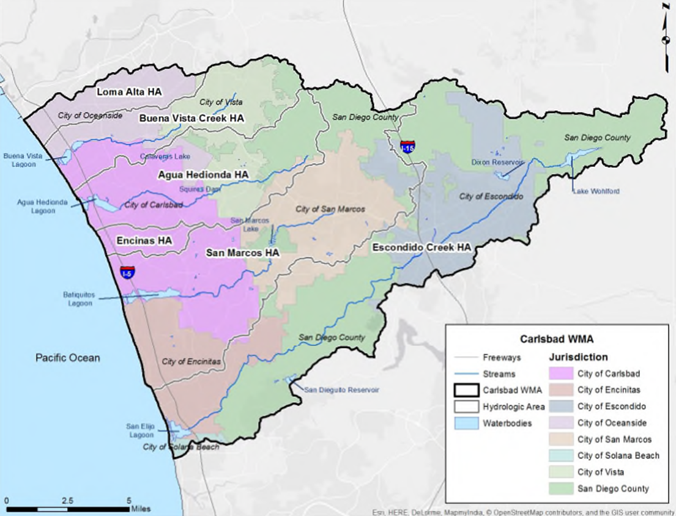
What is a Watershed?
Notes:
10 Watersheds – San Diego County, South Orange County, and South Riverside County

Slide 12
Water Quality Improvement Plan
Comprehensive watershed planning document that assists Responsible Agencies in establishing and implementing priorities, goals, and strategies for individual jurisdictional programs.
Goal: Further CWA objective to protect, preserve, enhance, and restore water quality and beneficial uses.
Fosters watershed interconnectivity and allows for adaption based on program implementation and monitoring.

Slide 13
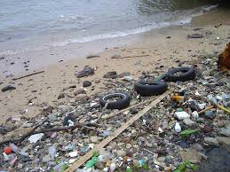
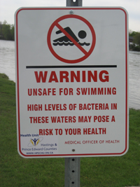
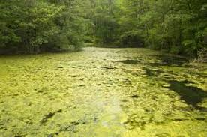
Highest Priority Water Quality Conditions
Prioritize and focus on specific pollutants impacting receiving waters.
HPWQC Examples:
Trash
Nutrients
Metals
Bacteria
Notes:
Relate to audience as this creates a “stormwater” to do list to prioritize what needs to be addressed, similar to figuring out priorities for property maintenance.

Slide 14
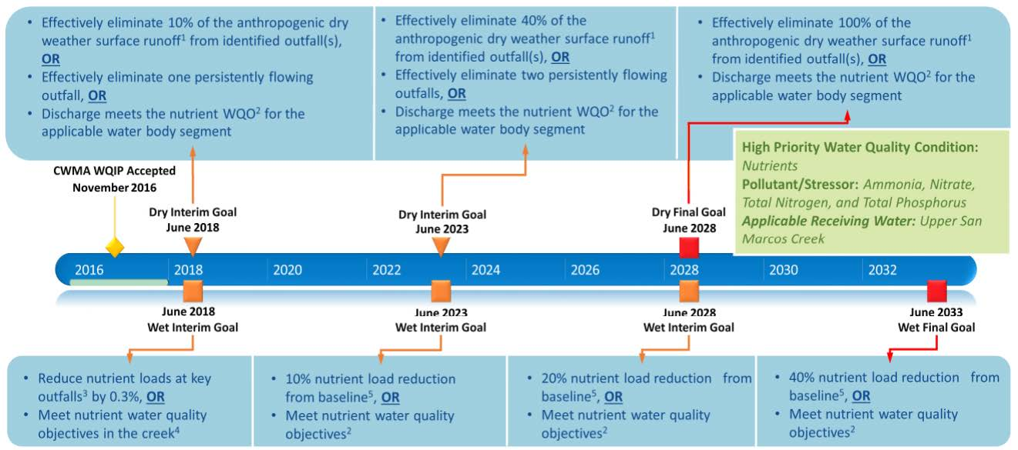
Numeric Goals and Schedules
Goals & Schedules for HPWQC establish targets that RAs use to establish programs and to measure progress/success.
San Marcos Hydrologic Area - Upper

Slide 15
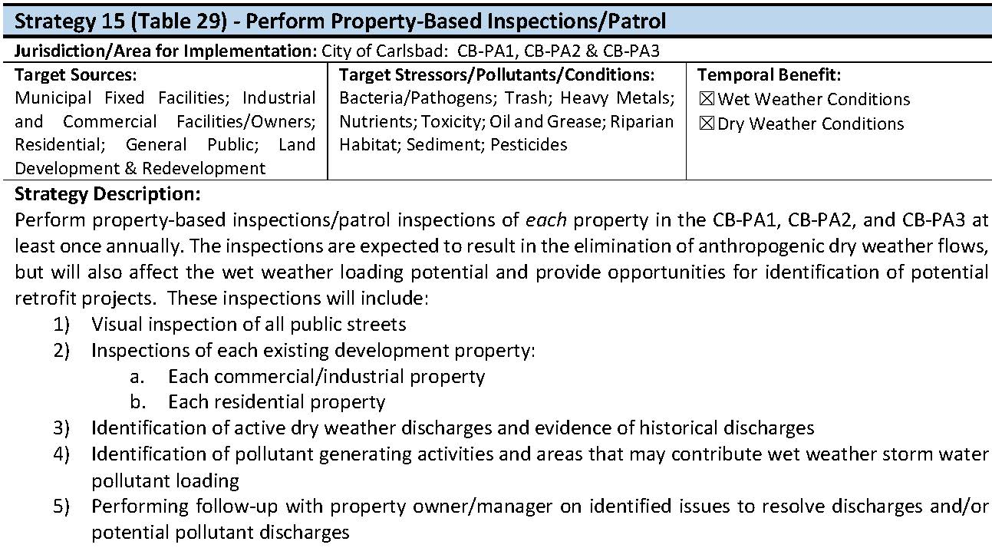
Strategies

Slide 16
Strategies Cont.

Slide 17
Strategies Cont.

Slide 18
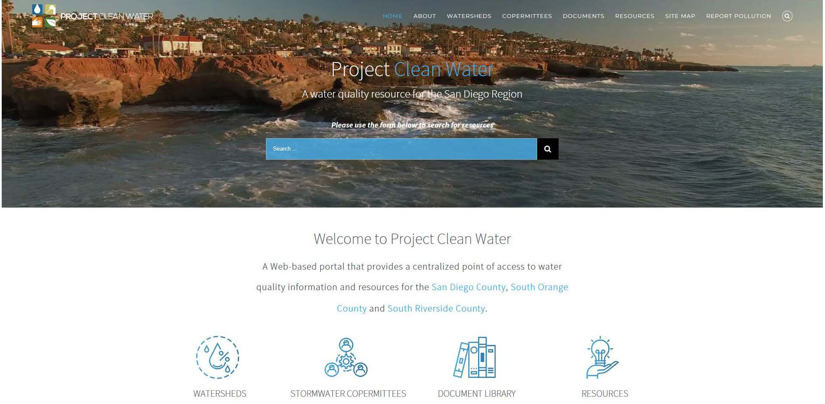
Project Clean Water
WWW.PROJECTCLEANWATER.ORG

Slide 19
How Does this Affect You?
MS4 Permit/JRMP requirements regulates many of your daily activities and functions.
Many WQIP Strategies center around this audience (like today!).
Working Collaboratively = Being Part of the Solution
Thank you!

